Slide 1
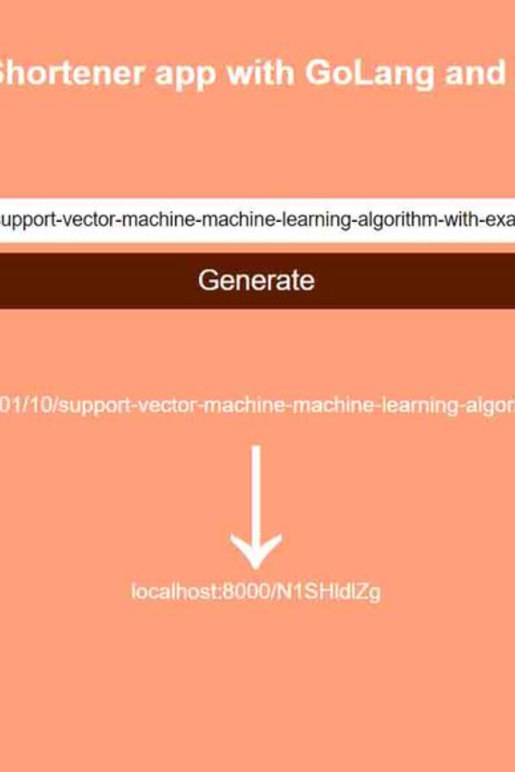

ss
by sabiha shaik

